Slide 1


Gym Management System
----------------------------------------------------------------
----------------------------------------------------------------
DATA BASE Team Project
501_Team1
Leader: C089049 이정혁
C089018 김윤호
C089051 이진우
C293195 이재범

Slide 2
Index
............................................................................................
1. DB Topic & Motivation
2. Project participation
3. Require Specification
4. UI Design
5. DB Design(Relation Schema)
6. Code Design
7. Implementation&Test
8. Conclusion/Expectation

Slide 3


01
Topic & Motivation

Slide 4
Topic
Efficient GYM Management DB System

Slide 5
Motivation
Why need this DB system for GYM management?
- To Manage efficient members
- To manage trainer and class schedules accurately.
- To improve operational efficiency.

Slide 6
02
Project Participation

Slide 7




Project Participation
Lee Jung Hyeok
(Team Leader)
Lee Jin Woo
▪ DB TOPIC Consultation.
▪ Assistance with organizing the DB table as a whole
▪ Homepage organization and development
▪ Assistance with overall homepage structuring
▪ Active participation in DB meetings
▪ DB TOPIC Consultation.
▪ Homepage organization and development
▪ Assistance with overall homepage structuring
▪ Active participation in DB meetings
▪ PPT production
20%
40%
Kim Yun Ho
Lee Jae Beom
▪ DB TOPIC Consultation.
▪ Assistance with organizing the DB table as a whole
▪ Homepage organization and development
▪ Assistance with overall homepage structuring
▪ Active participation in DB meetings
▪ DB TOPIC Consultation.
▪ Assistance with organizing the DB table as a whole
▪ Homepage organization and development
▪ Assistance with overall homepage structuring
▪ Active participation in DB meetings
20%
20%

Slide 8
03
Requirement Specification

Slide 9
Requirement Specification
Functional requirements
- Only administrators(trainers) can operate management functions.
- Member registration and withdrawal are available.
- Member search functionality is provided.
- Check locker activation and deactivation status.
- ID duplication is not allowed.
- Passwords are encrypted in the database.
- Modification and deletion of member and administrator information are supported.

Slide 10
04
UI Design

Slide 11
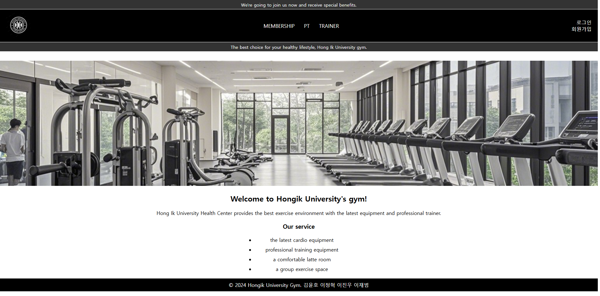
<Main Page>
UI Design

Slide 12
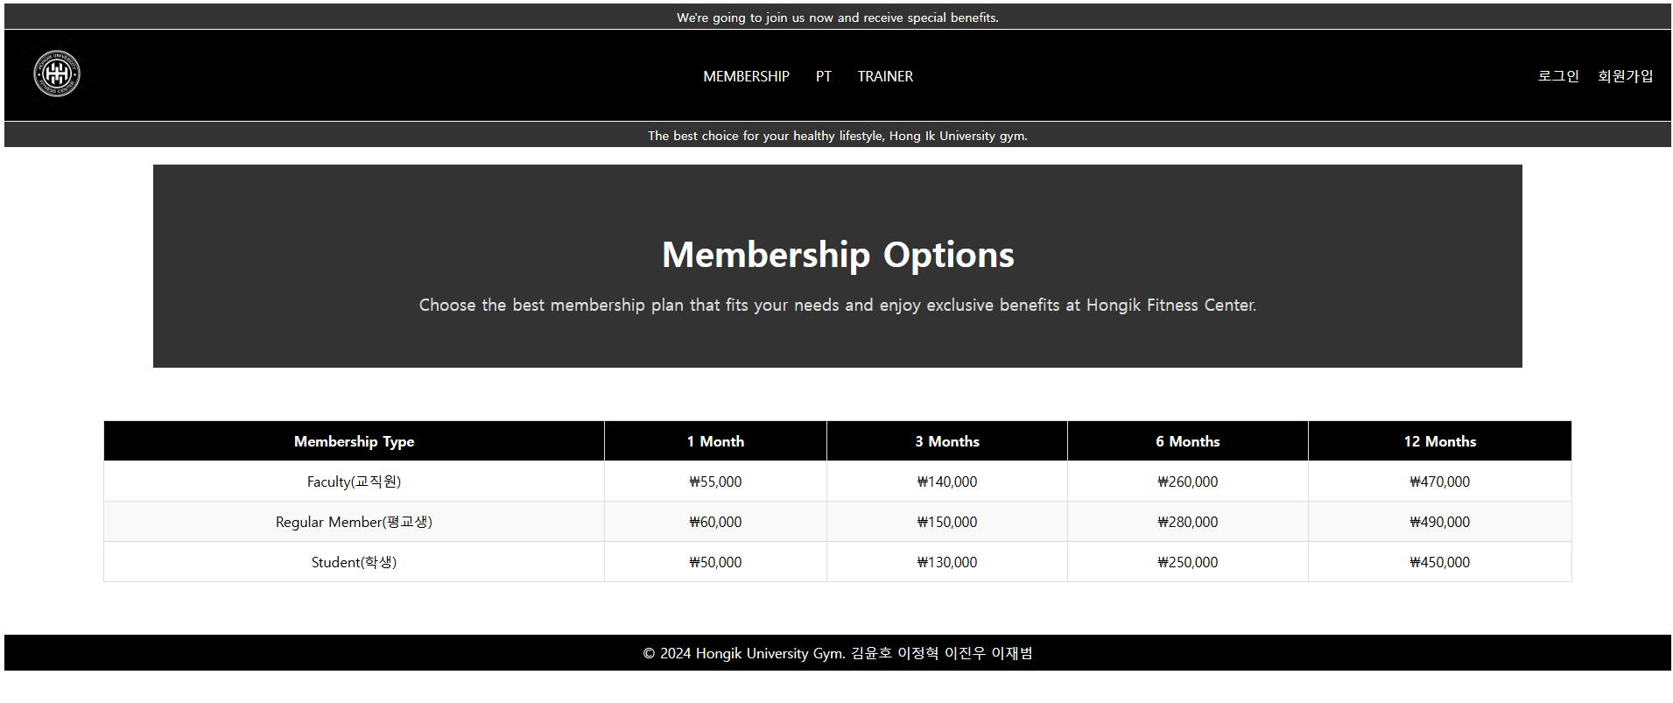
<Membership>
UI Design

Slide 13
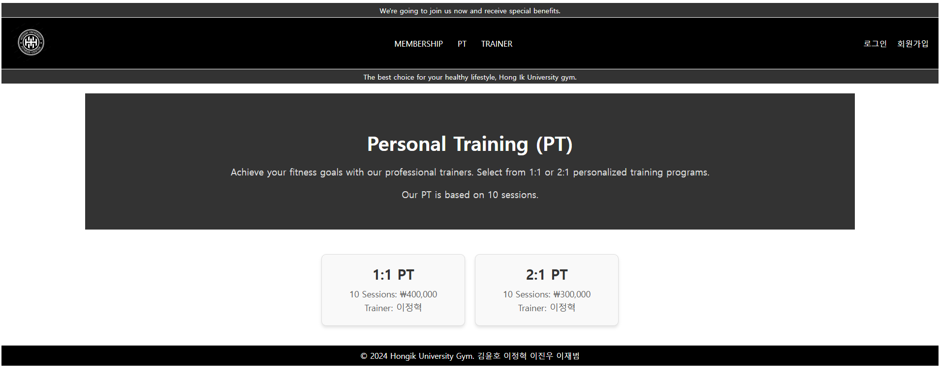
<PT>
UI Design

Slide 14
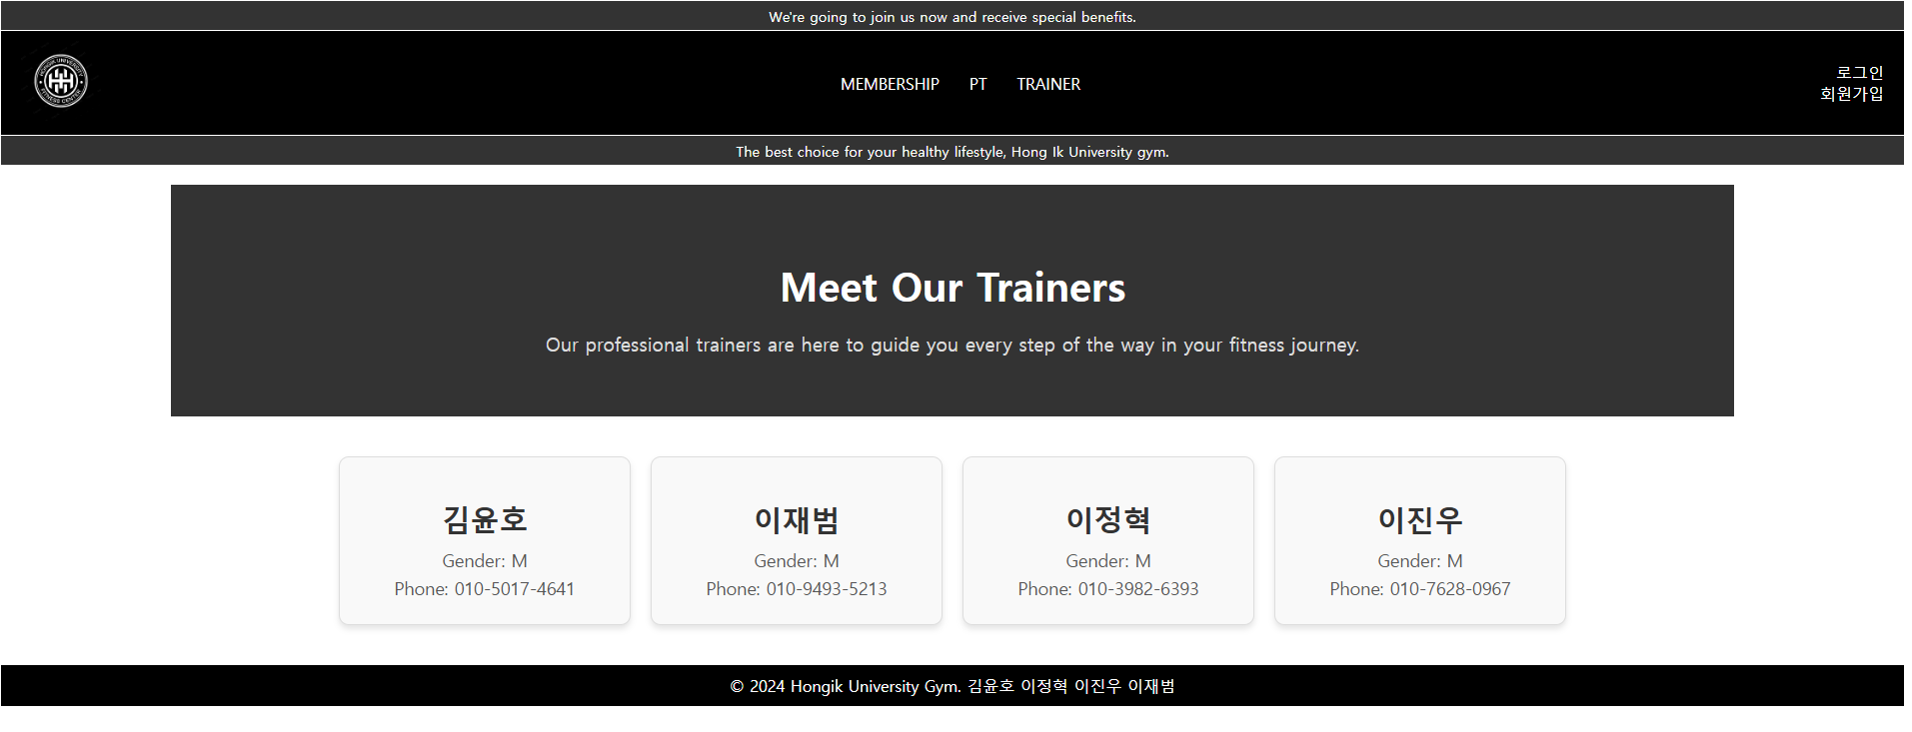
<Trainer>
UI Design

Slide 15

UI Design
<Login>

Slide 16
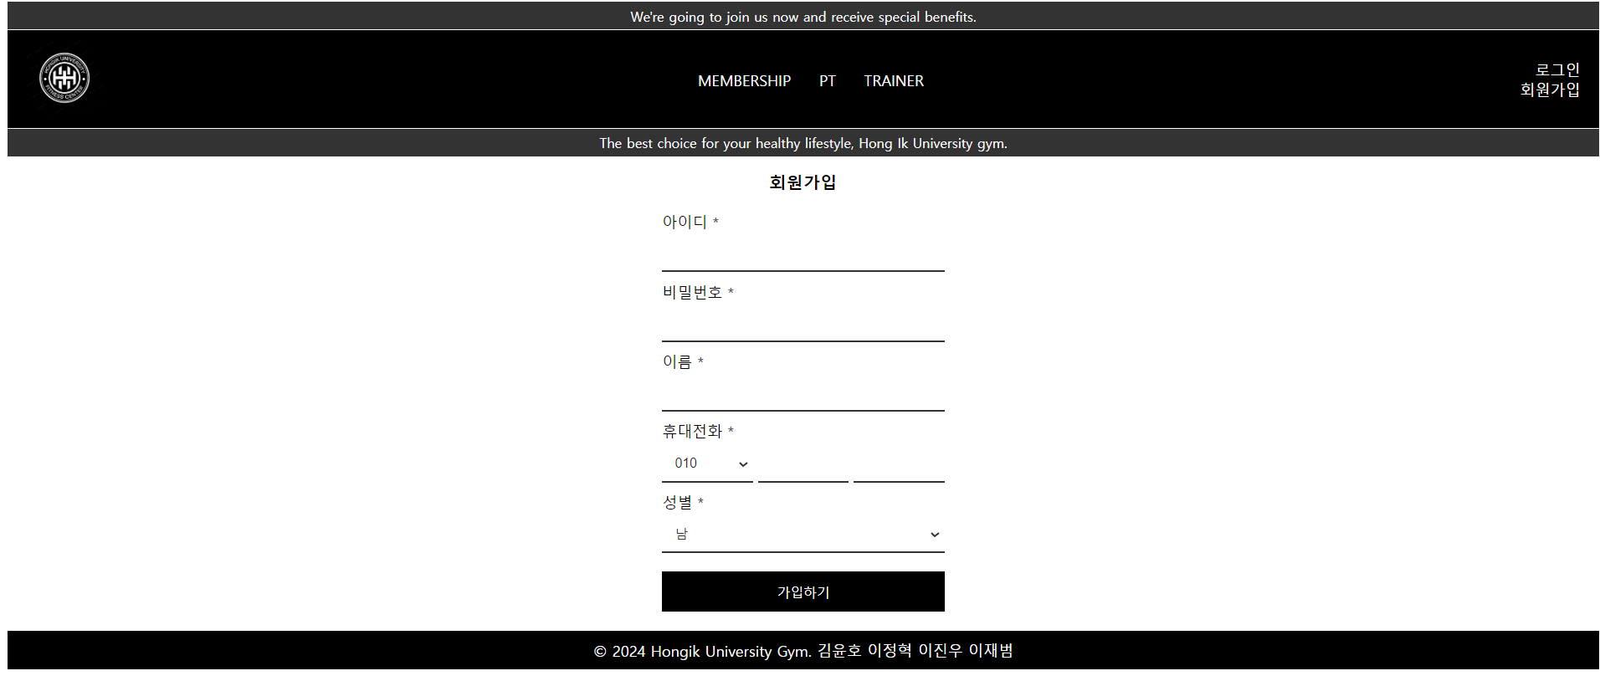
<Registration>
UI Design

Slide 17
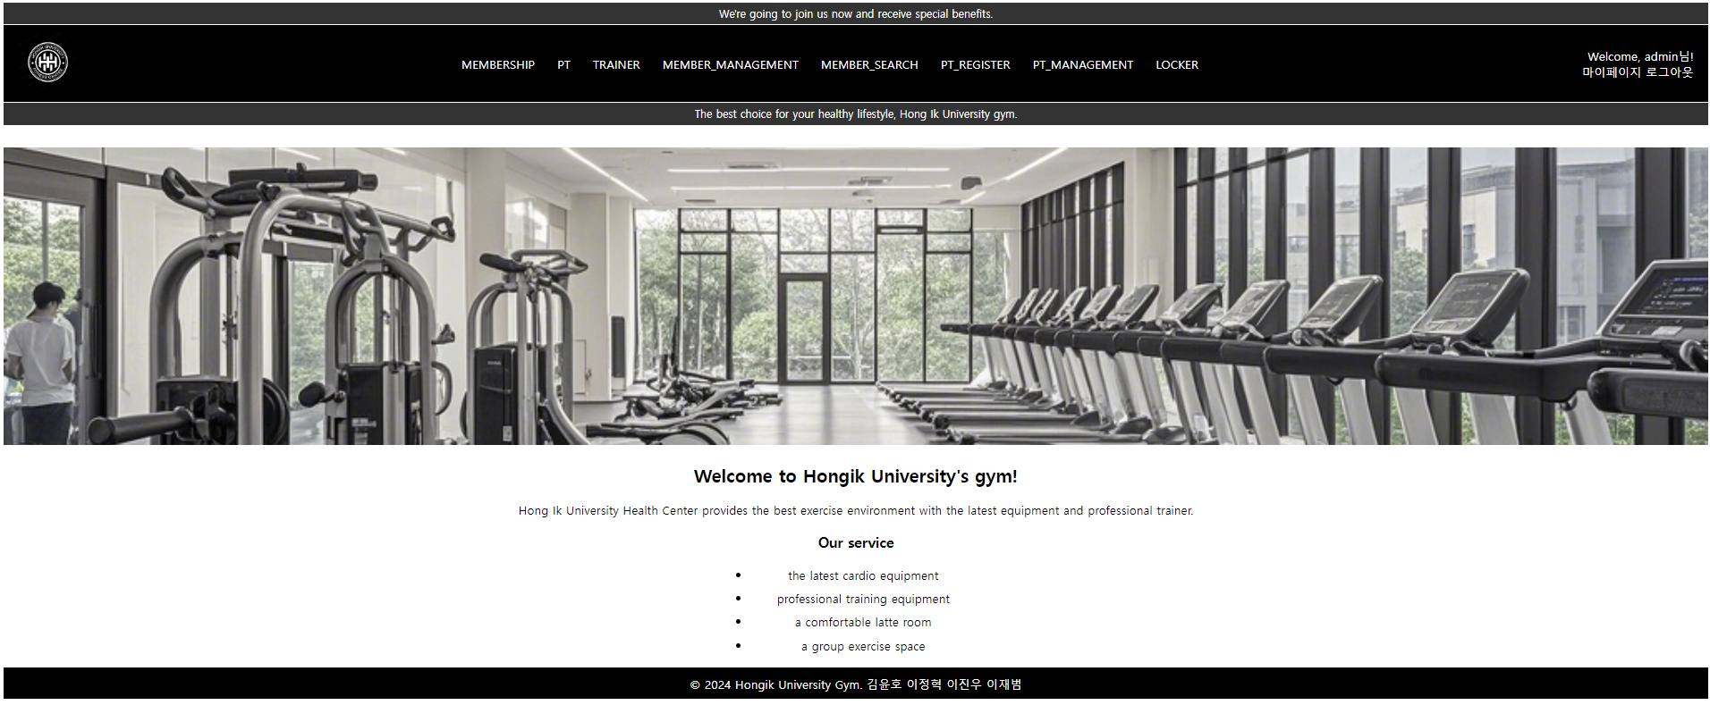
<Home page after logging in>
UI Design

Slide 18
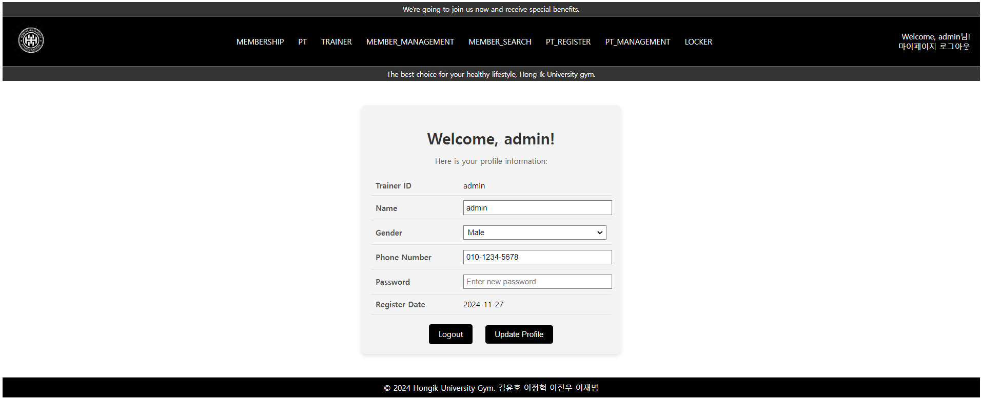
<My Page>
UI Design

Slide 19

<Member management>
UI Design

Slide 20
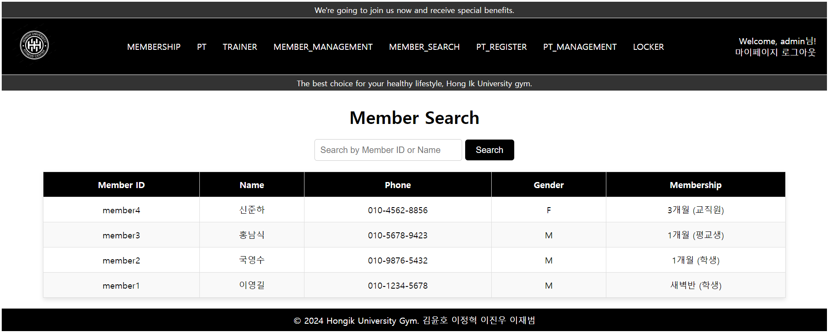
<Member Search>
UI Design

Slide 21
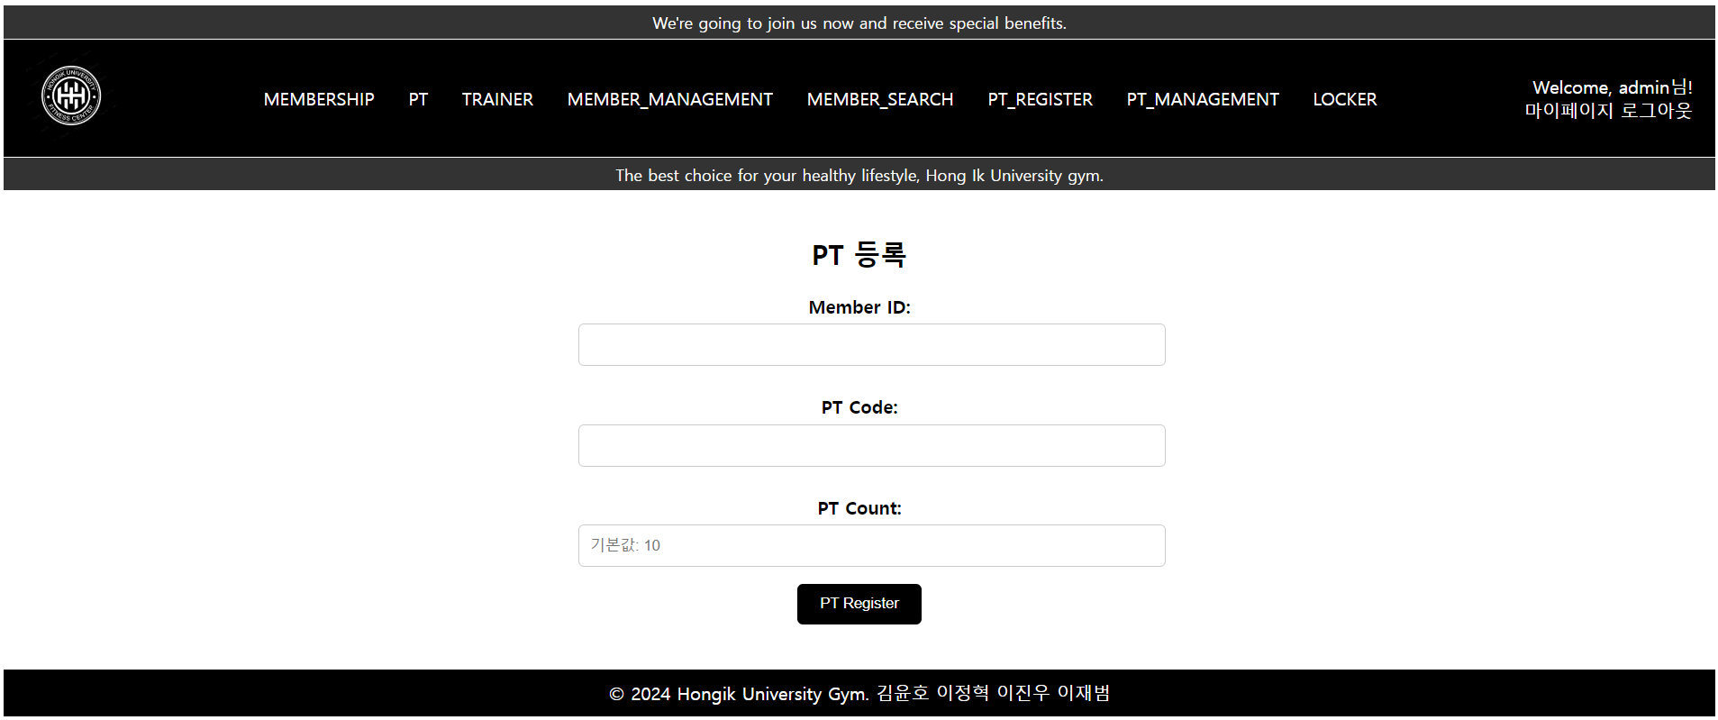
<PT register>
UI Design

Slide 22
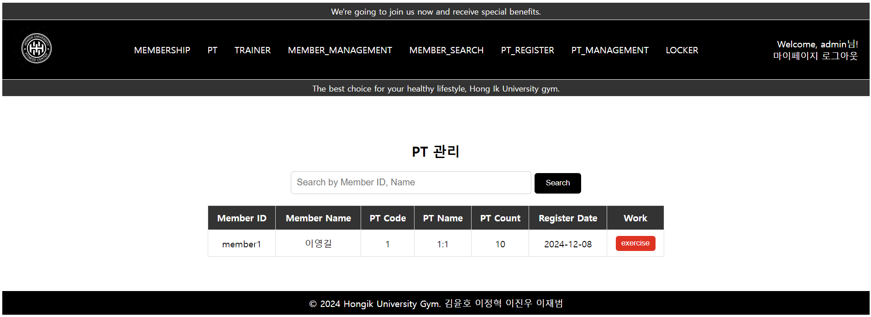
<PT management>
UI Design

Slide 23
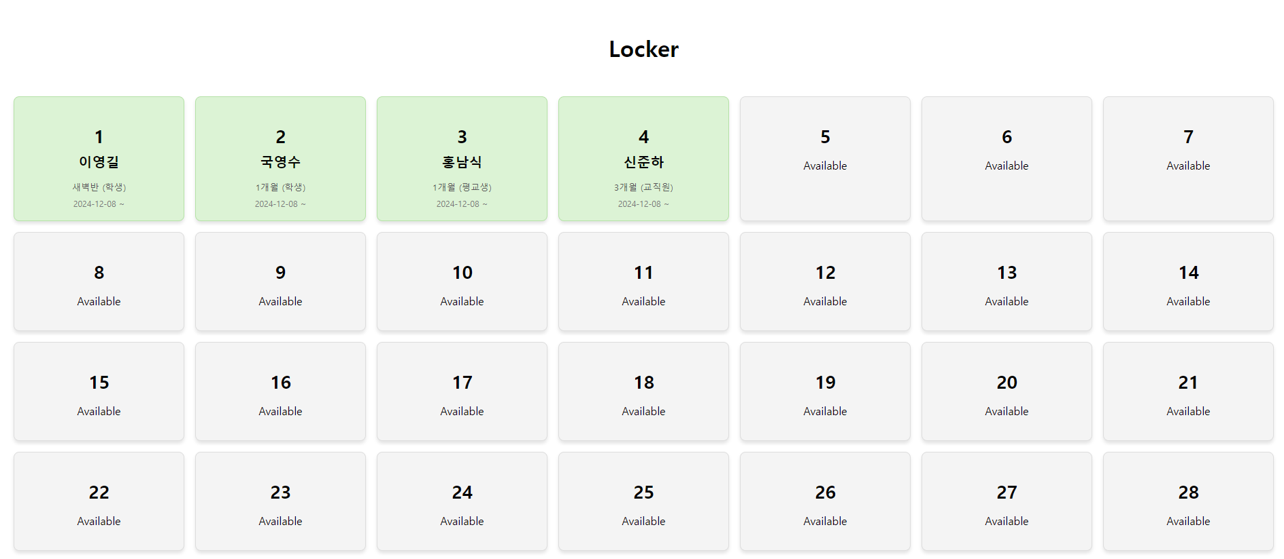
<Locker>
UI Design

Slide 24
05
DB Design
(Relational Schema)

Slide 25
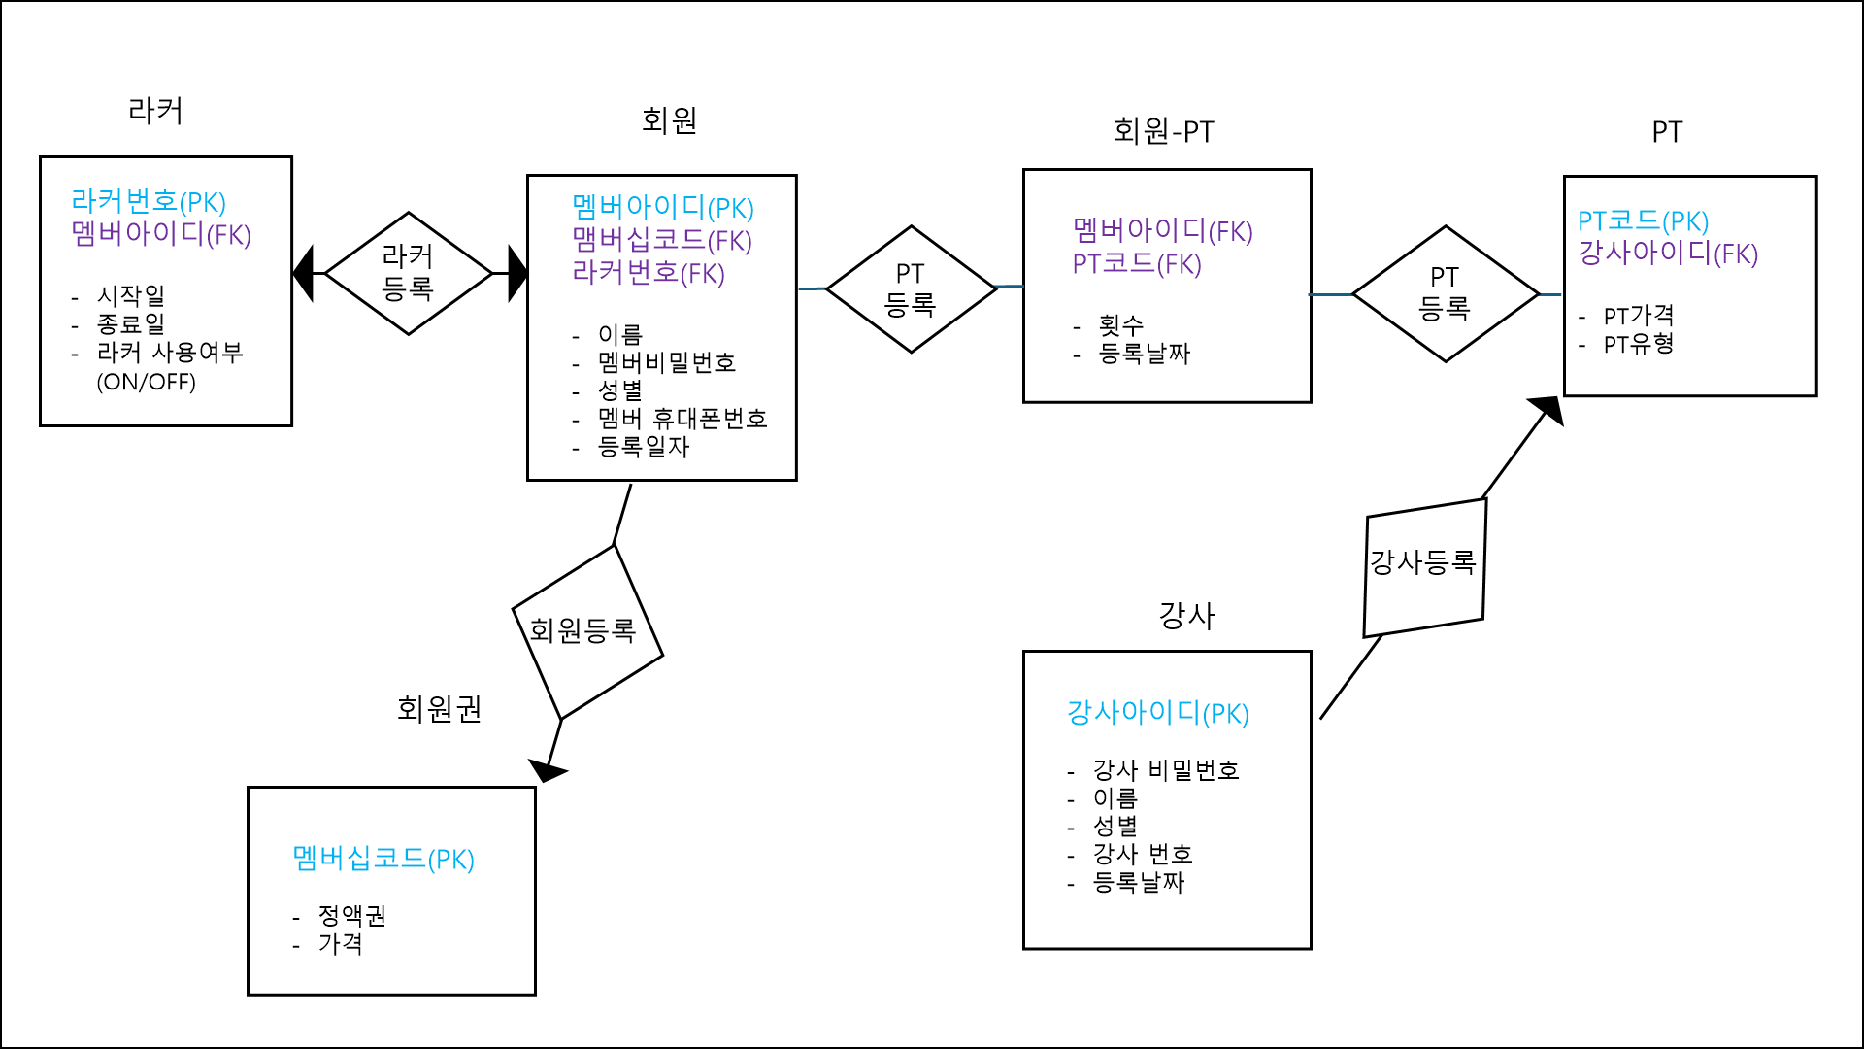
ER Diagram

Slide 26
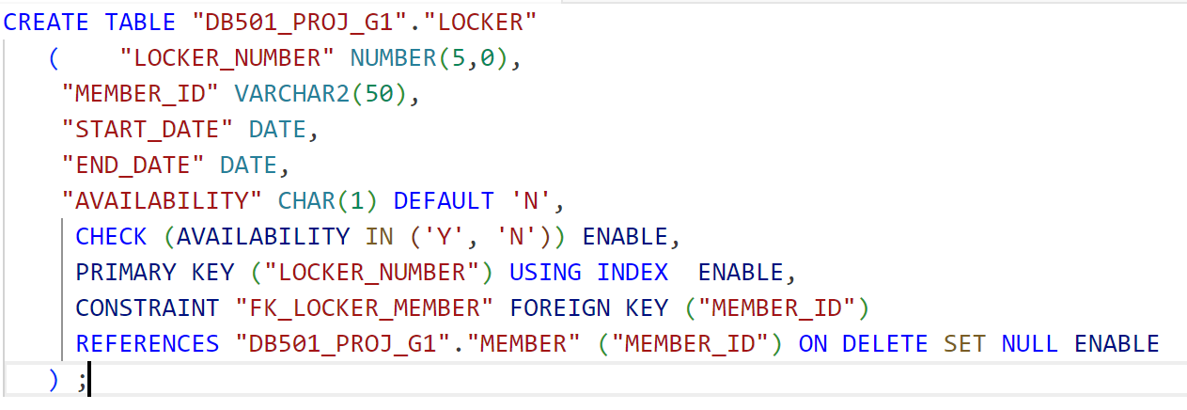
DB Design
LOCKER
라커번호 | 멤버아이디 | 시작일 | 종료일 | 사용가능여부
LOKER_NUMBER | MEMBER_ID | START_DATE | END_DATE | AVAILABILITY
NUMBER(5) | VARCHAR2(50) | DATE | DATE | CHAR(1)
PRIMARY KEY
FOREIGN KEY

Slide 27
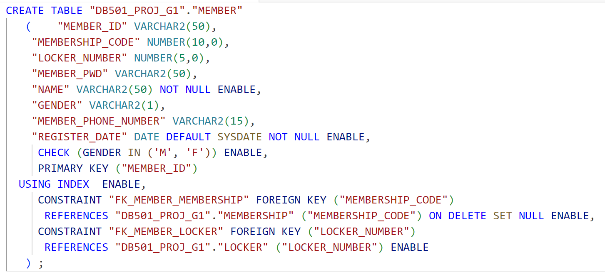
DB Design
MEMBER
멤버아이디 | 멤버쉽코드 | 라커번호 | 멤버비밀번호 | 이름 | 성별 | 멤버 휴대폰번호 | 등록일자
MEMBER_ID | MEMBERSHIP_CODE | LOCKER_ NUMBER | MEMBER_PWD | NAME | GENDER | MEMBER_PHONE_NUMBER | REGISTER_DATE
VARCHAR2(50) | NUMBER(10) | NUMBER(5) | VARCHAR2(50) | VARCHAR2(50) | VARCHAR2 (50) | VARCHAR2(1) | VARCHAR2(15)
PRIMARY KEY
FOREIGN KEY

Slide 28
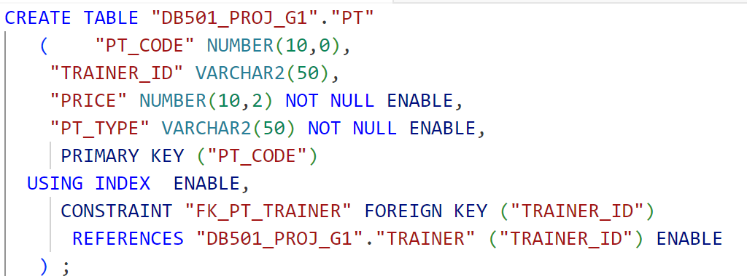
DB Design
PT
PT 번호 | 강사 아이디 | PT 가격 | PT 유형
PT-CODE | UserID | Price | PT-Type
NUMBER(10) | VARCHAR2(50) | NUMBER(10,2) | VARCHAR2(50)
PRIMARY KEY
FOREIGN KEY

Slide 29
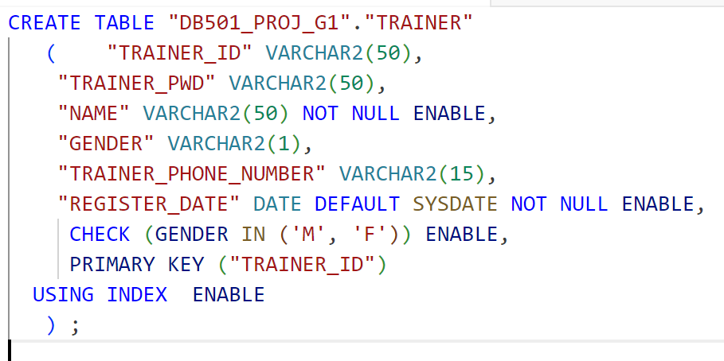
DB Design
Trainer
강사 아이디 | 강사 비밀번호 | 이름 | 성별 | 강사 번호 | 등록 날짜
TRAINER_ID | TRAINER_PWD | NAME | GENDER | TRAINER_ PHONE_NUMBER | REGISTER_DATE
VARCHAR2(50) | VARCHAR2(50) | VARCHAR2(50) | VARCHAR2(1) | VARCHAR2(15) | DATE
PRIMARY KEY
FOREIGN KEY

Slide 30
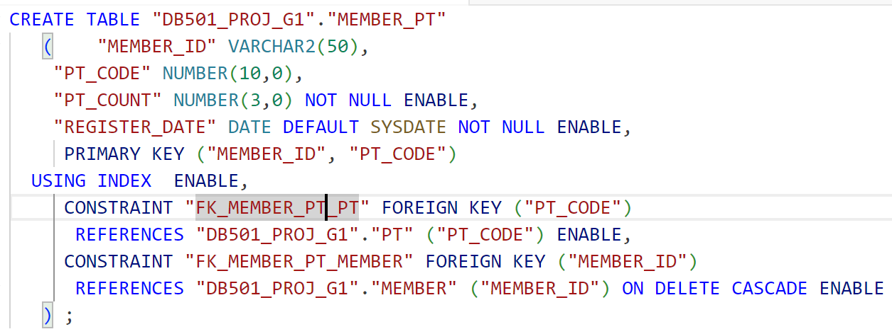
DB Design
Member_PT
멤버아이디 | PT 코드 | PT 횟수 | 등록 날짜
MEMBER_ID | PT_CODE | PD_COUNT | REGISTER_DATE
VARCHAR2(50) | NUMBER(10,0) | NUMBER(3,0) | DATE
PRIMARY KEY
FOREIGN KEY

Slide 31
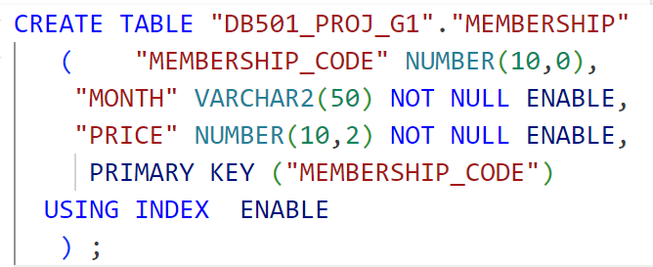
DB Design
Membership
멤버십 코드 | 정액권 | 가격
MEMBERSHIP_CODE | MONTH | PRICE
NUMBER(10,0) | VARCHAR2(50) | NUMBER(10,2)
PRIMARY KEY
FOREIGN KEY

Slide 32
Relational Schema
MEMBER : MEMBERSHIP = 1 : n
MEMBER : LOCKER = 1 : 1
PT : TRAINER = n : 1
PT : MEMBER = m : n
MEMBER_PT : MEMBER = n : 1
MEMBER_PT : PT = n : 1

Slide 33
06
Code Design

Slide 34
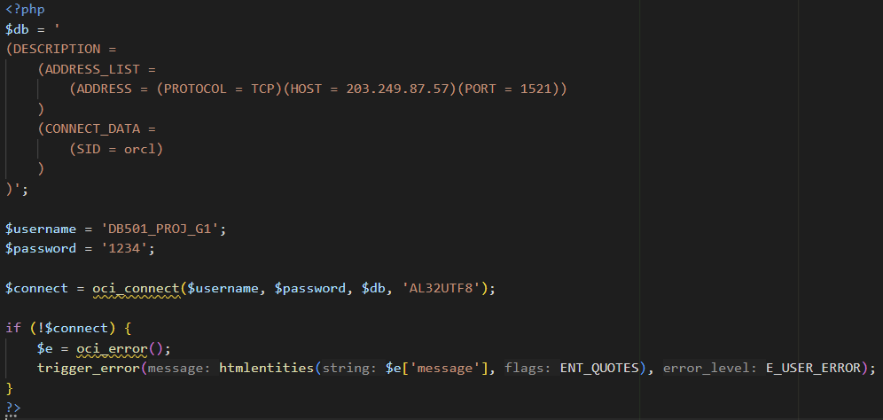
<DB Connect>
Code Design
Set the host, port, SID, username, and password, and initialize the connection to connect to the Oracle database.

Slide 35
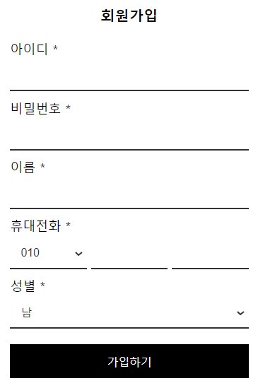
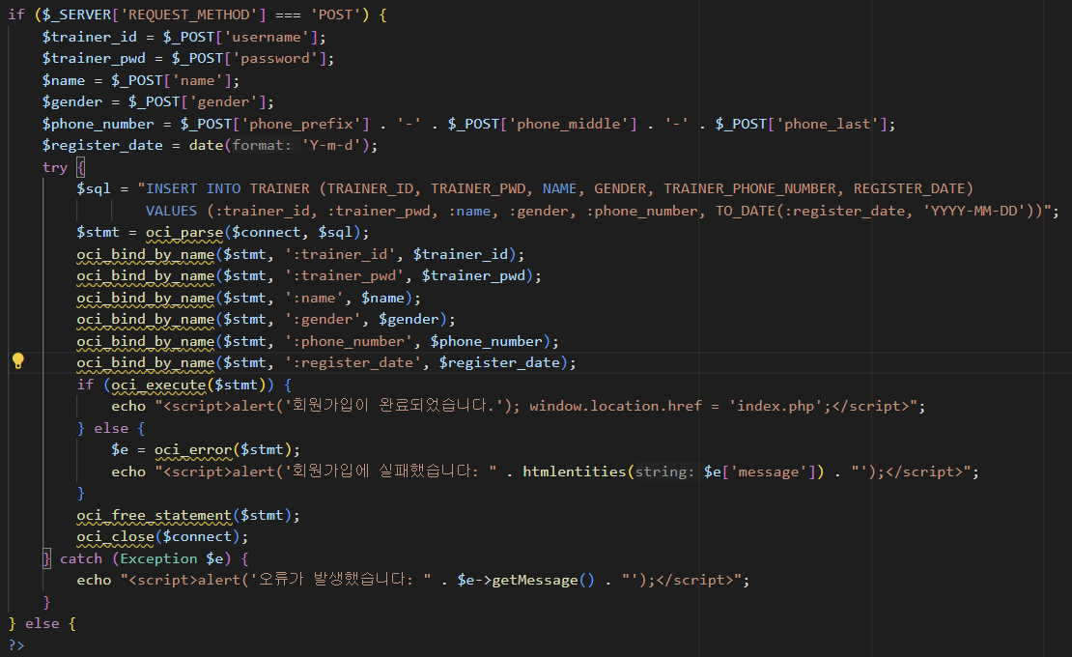
<Registration>
Code Design
After completing the registration, the user-submitted registration data is inserted into the TRAINER table of the Oracle database.

Slide 36
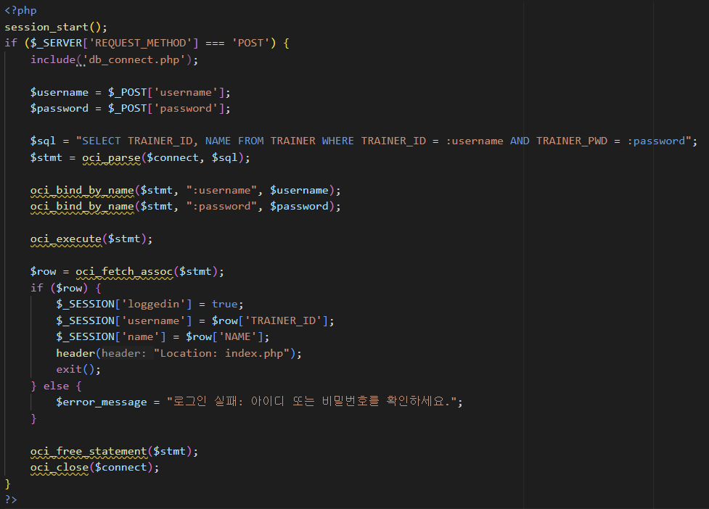
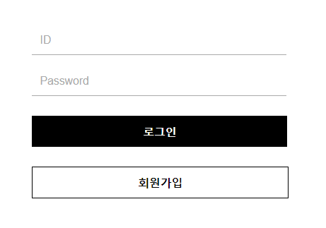
Code Design
<Login>
User authentication is performed through the database using the input provided by the user to verify the login status.

Slide 37
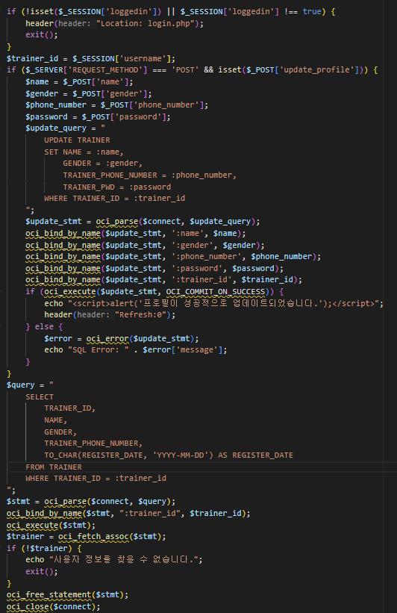
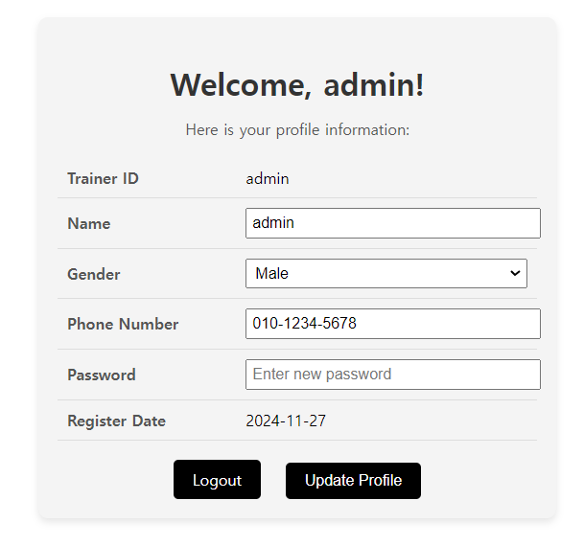
<My Page>
Code Design
Based on the trainer's session information, profile details are retrieved, and any modified content is updated.

Slide 38
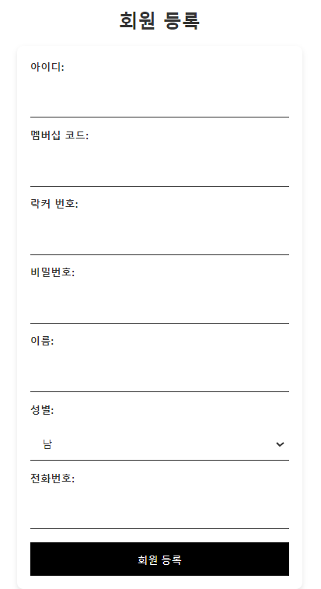
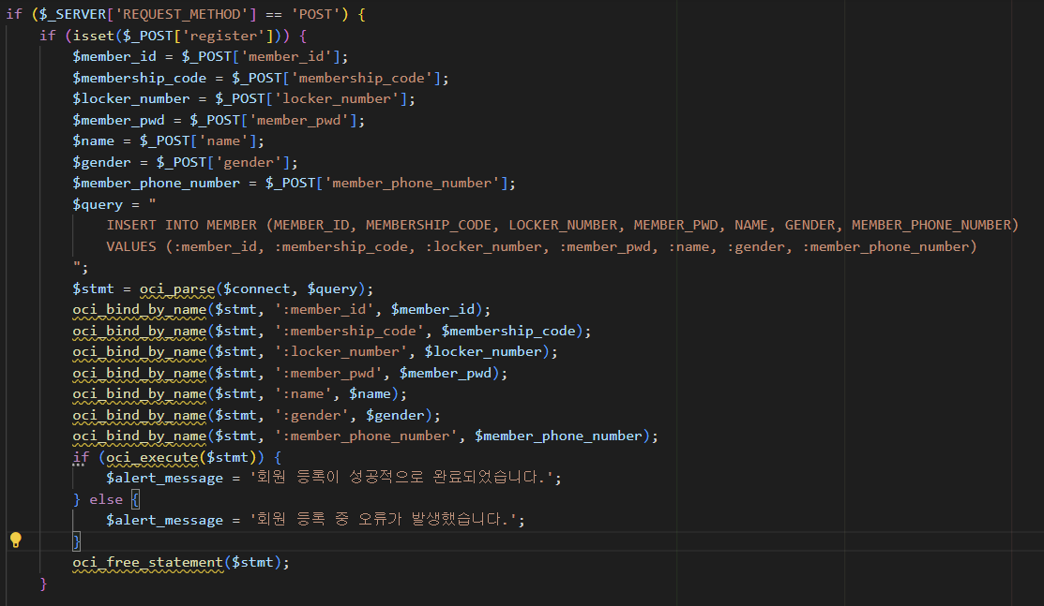
Code Design
<Member management>
The user-submitted membership information is inserted into the MEMBER table to process the registration.

Slide 39
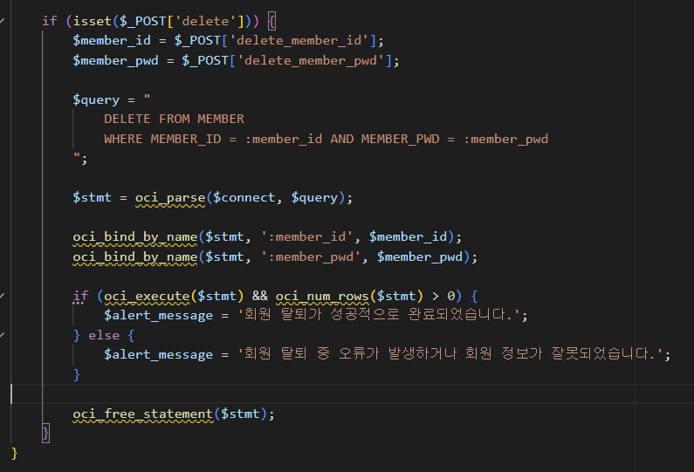
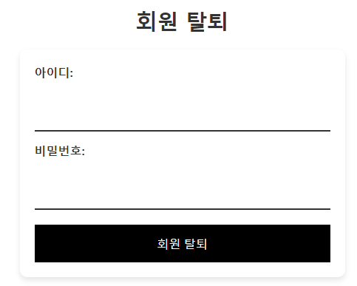
Code Design
<Member management>
The function deletes the corresponding member information from the MEMBER table based on the user-inputted member ID and password.

Slide 40
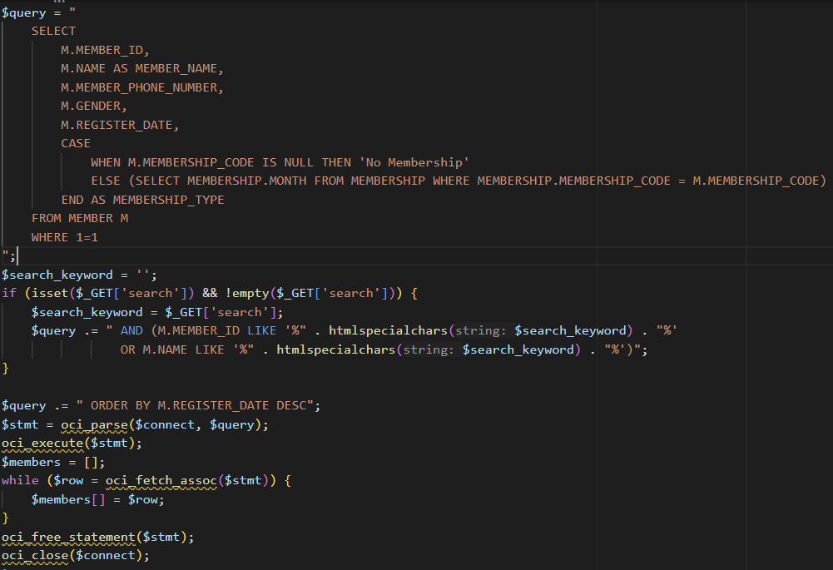
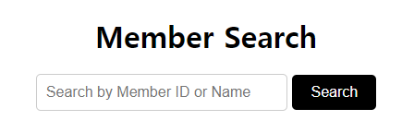
<Member Search>
Code Design
The member information is filtered and sorted based on the member ID and name for retrieval.

Slide 41
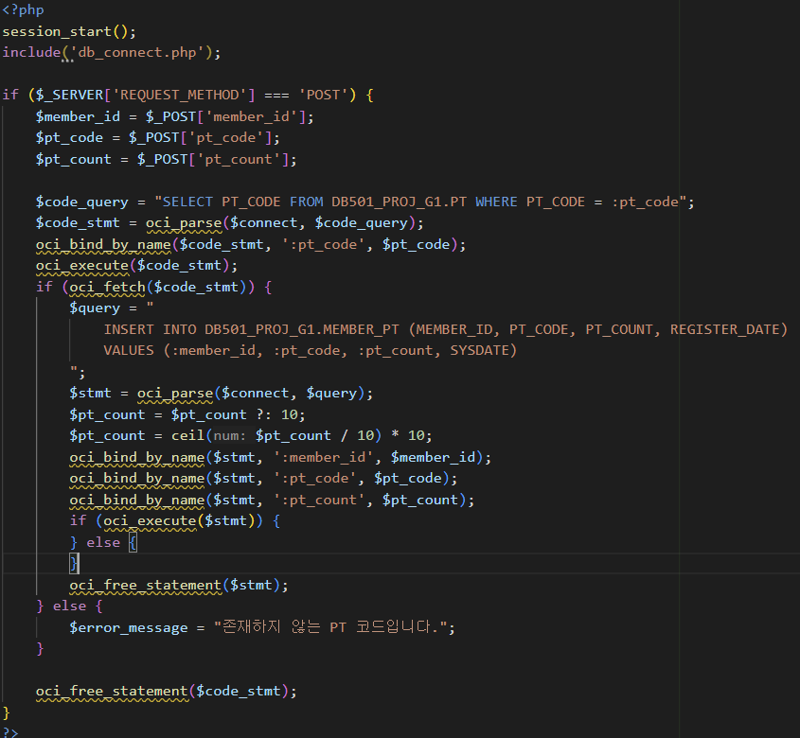
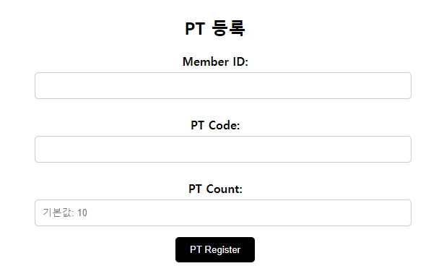
<PT register>
Code Design
After verifying the validity of the member PT code, the PT information is inserted into the MEMBER_PT table if valid.

Slide 42
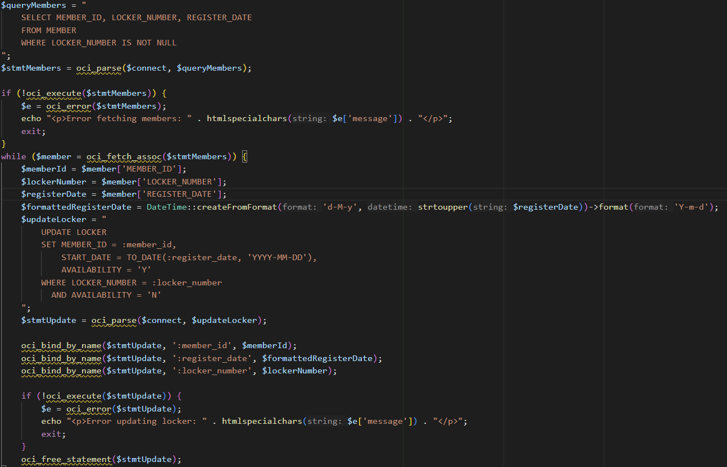
<Locker>
Code Design
The member data is retrieved, and if locker information is available, the locker status is updated.

Slide 43
07
Implementation & Test

Slide 44

Implementation & Test
http://203.249.87.58/1_team/1_team1/gym_website/index.php

Slide 45
08
Conclusion / Expectation

Slide 46
Conclusion
1. Importance of Database Design
Understanding the critical role of database design in managing data systematically and ensuring system performance and stability.
2. Understanding of Table Relationships
Gaining expertise in designing table relationships and effectively querying and managing relational databases.
3. Experience with PHP and Oracle Integration
Developing skills in integrating PHP with Oracle to process real-time data, visualize results, and design user-centered interfaces while ensuring system stability.

Slide 47
Expectation
1. Member Management Efficiency
Systematic management of member information, memberships, PT programs, and lockers simplifies trainers' tasks and boosts efficiency.
2. Data-Driven Insights
Real-time data on registrations, program participation, and locker usage helps improve operational efficiency and service quality.
3. User Experience Enhancement
Intuitive features like easy login, registration, and PT program management provide convenience for both trainers and members.

Slide 48
Thank you

